Slide 1

ASC Auction Platform Architecture December 7th, 2020
Estimator: Isanka Rathnayaka

Slide 2

ASC Auction platform high-level architecture
Technology Stack
Main use cases in ASC Auction platform

Slide 3
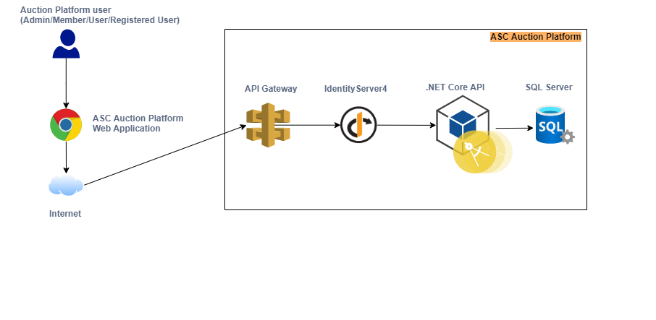
ASC Auction platform High-Level Architecture

Slide 4
Technology Stack
Component | Tech Stack | Remarks
ASC Auction Platform SPA Web App | Angular 10 | Less learning curve Opiniated framework – Hence less decision making Long Term Support (LTS) Proper documentation.
API Gateway | Ocelot | Open Source . NET Core based API Gateway especially made for microservices
Identity Server (IDP) | Identity Server 4 | Provide the capability to delegate the entire security mechanism and keep it separate from the application. Used Authorization code flow + PKCE
Authentication | Open ID Connect | Supports well for modern applications.
Authorization | OAuth 2 | Authorization protocol
Web API | .NET Core 3.1 ORM – Entity Framework Core 5.0 Validation – FluentValidation.AspNetCore 9.3.0 Logging – Nlog Caching – Redis Automated Unit Testing – Xunit API Documentation - Swagger

Slide 5
Main use cases in ASC Auction platform
 | Use Case | Flow | Description
1 | Grant access to ASC Auction platform user as an admin or member. | User → Web Portal → API Gateway(Ocelot) → IDP server (Identity Server 4) → Web API | In order to grant access to a web portal admin, the admin user should be an already registered user. User will get authenticated and authorized by IDP server
2 | Guest user sign up an existing email ID. | User → Web Portal → API Gateway(Ocelot) → IDP Server(Identity Server 4) | Upon typing the default auction platform URL, the guest user will get an option to sign up and upgrade to a registered user. (IdentityServer4 user registration page)
3 | Grant access to ASC Auction platform user as a registered user. | User → Web Portal → API Gateway(Ocelot) → IDP server (Identity Server 4) → Web API | In order to grant access to a web portal admin, the admin user should be an already registered user. User will get authenticated and authorized by IDP server via role-based authorization.

Slide 6



